Slide 1


Image Caption Generator
By Raj Patel(1566779)

Slide 2

Introduction
How does a Human Understand?
Human uses their brain
How does the Computer Understand?
Computer Vision
Natural Language Processing

Slide 3
Applications on Image Captioning
Automatic Description
For
Surveillance
Systems
Visual
Storytelling
And
Entertainment
Autonomous
Vehicles
And
Robotics
Notes:
Automatic Description for Surveillance Systems: Image caption generators can be integrated into surveillance systems to automatically generate descriptions for captured images or video frames. This aids in understanding the content of the surveillance footage without human intervention, making it easier to analyze and search through large volumes of visual data.
Autonomous Vehicles and Robotics: Image caption generators can be employed in autonomous vehicles or robotic systems to provide real-time descriptions of the surrounding environment. This assists in object recognition, navigation, and decision-making processes, enabling safer and more efficient operation.
Visual Storytelling and Entertainment: Image caption generators can be used to create descriptive captions for images or sequences of images, enabling the creation of visual stories, comics, or picture books. This can be utilized in entertainment, advertising, or digital storytelling applications.

Slide 4

Datasets
Flickr8k
Images: 8092
Captions: 40455
Flickr30k
Images: 32k
Captions: 159k
MS COCO
Images: 123k
Captions: 615k
All Dataset Contains 5 captions per image

Slide 5

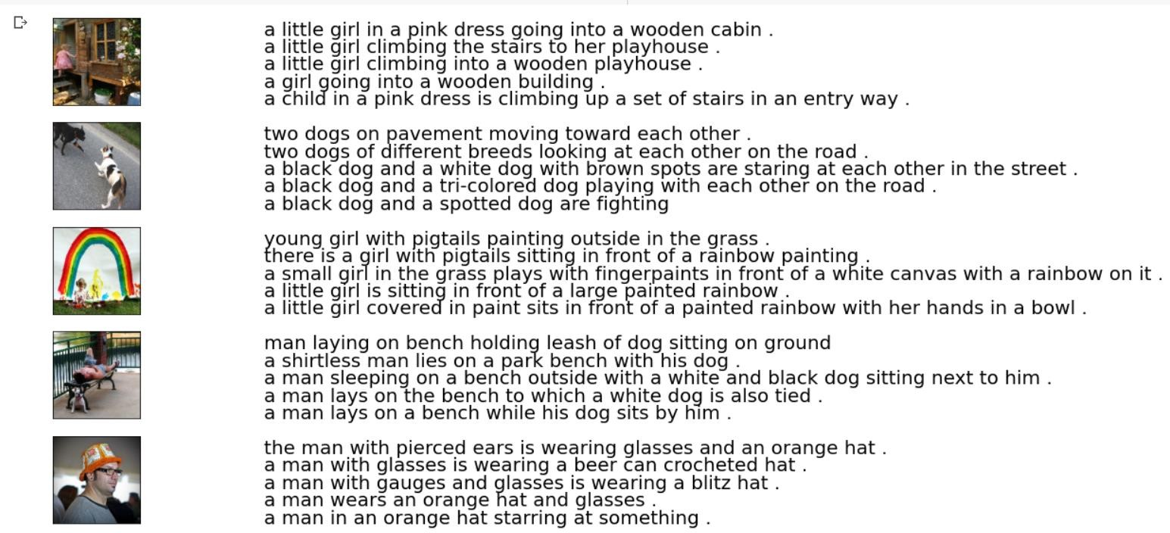
Looking at Data

Slide 6
Data Cleaning
Text Pre-processing
Image Pre-processing

Slide 7
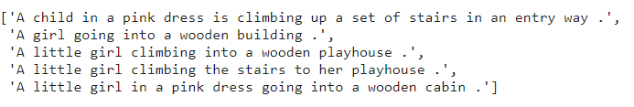
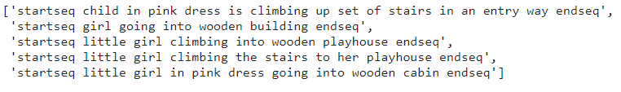
Text Pre-processing
Before Preprocessing
After Preprocessing

Slide 8
Image Pre-Processing
What is feature extraction?
Feature Extraction reduces the number of features by creating new features from the existing ones and then discarding the original features. These new reduced sets of features summarize most of the information in the original set. I have used ResNet50 for this task.
What is RestNet50?
Pretrained Model on ImageNet Dataset and uses skip connections.

Slide 9

Why use Resnet50 ?
Networks with many layers can be trained easily without increasing the training error percentage.
ResNets help in tackling the vanishing gradient problem.
ResNets are relatively faster than other pre-trained CNN transfer models
Extracted Feature

Slide 10
Train/Test Split
 | 90% | 10%
 | Training Data | Testing Data
Why not a validation set?
Image Data Generator and Hardware

Slide 11
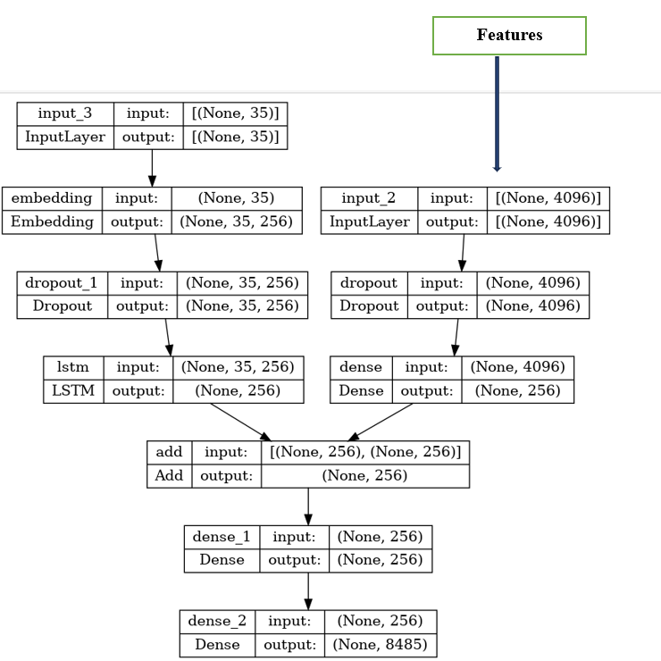
Model Building Using LSTM
E
N
C
O
D
E
R
D
E
C
O
D
E
R

Slide 12
Journey to Optimization
Run on 10 epochs and finally trained on 50 for 2 hours
Tried different optimizers and regularization techniques
Build a Model using LSTM and GRU
Saved extracted features in a pickle file and trained model in HDF5 file
Hardest is to plot the history function
Find BLEU Scoring

Slide 13
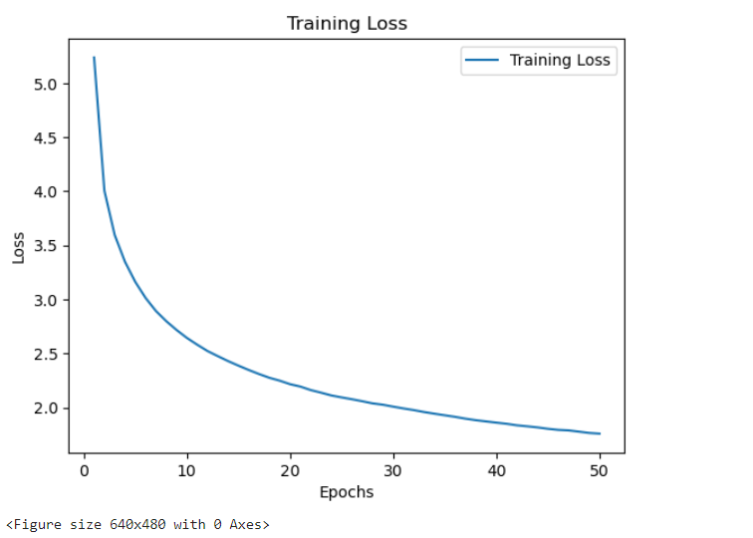
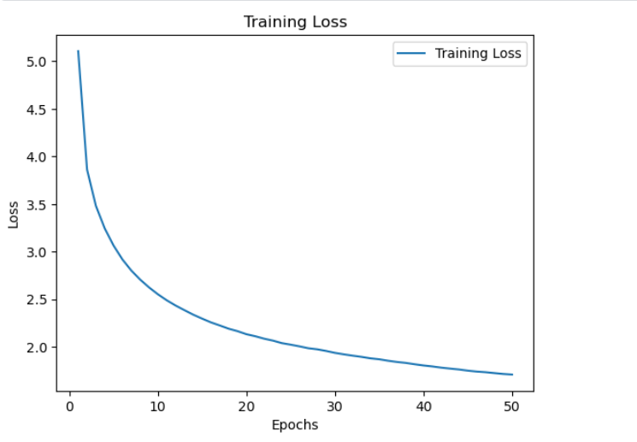
Addressing Bias & Variance
Loss For Model with GRU
Loss For Model with LSTM

Slide 14
Evaluating with BLUE
What is BLUE?
Evaluate machine-translated text
Score is between 0 to 1 and used n-gram for calculation
 | BLUE-1 | BLUE-2
LSTM | 0.543 | 0.320
GRU | 0.536 | 0.315

Slide 15
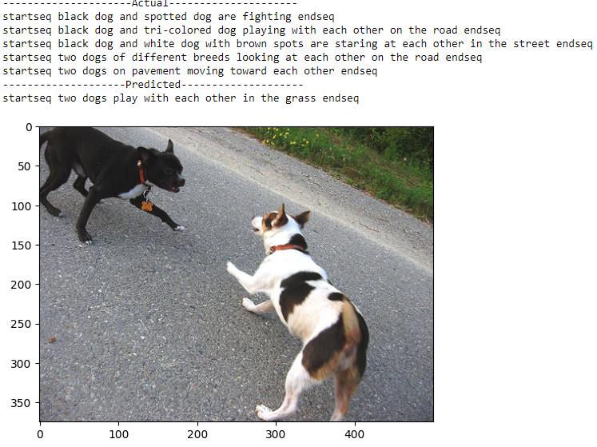
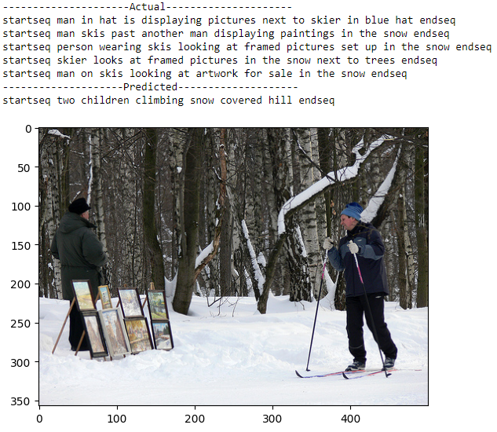
Visualizing Result

Slide 16

Future Direction
Increase the Number of epochs
Use More Data
Object Detection for feature extraction
BERT used as transfer learning for captions

Slide 17

THANK YOU

